Slide 1
Advanced higher Graphic communication
Colour Systems and Printing Methods

Slide 2
introduction
In this lesson you will learn about the different colour systems and printing methods and where each will be used.
The different colour systems that we will examine are:
  RGB
  CMYK
  Pantone
The different printing methods that we will examine are:
  Offset Lithography
  Flexography
  Screen Printing

Slide 3
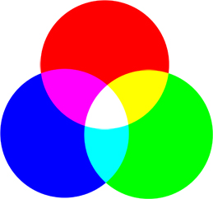
RGB
RGB is the colour scheme that is associated with electronic displays, such as monitors, digital cameras and scanners. It is an additive type of colour mode that combines the primary colours, red, green and blue, in various degrees to create a variety of different colours. When all three of the colours are combined and displayed to their full extent, the result is a pure white. When all three colours are combined to the lowest degree, or value, the result is black. Software such as photo editing programs use the RGB colour mode because it offers the widest range of colours.

Slide 4
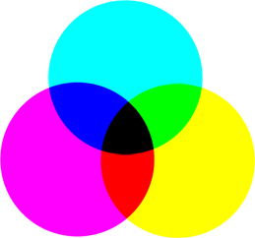
CMYK
If printers are using a digital printing method, they would print colour on paper using CMYK colours. This is a four colour mode that utilizes the colours cyan, magenta, yellow and black in various amounts to create all of the necessary colours when printing images. It is a subtractive process, which means that each additional unique colour means more light is removed, or absorbed, to create colours. When the first three colours are added together, the result is not pure black, but rather a very dark brown. The K colour, or black, is used to completely remove light from the printed picture, which is why the eye perceives the colour as black.

Slide 5
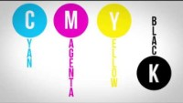
RGB or CMYK Which one to use?
In short, if you’re going to be printing something, such as a business card, stationary, or a newsletter, use CMYK. CMYK does not include a white colour because it is assumed that it will be printed on a white paper and depending on the percentage of each colour that is used, the white from the paper will be used to fill the space, therefore making the shades appear lighter.
If it’s something that will only be seen digitally, use RGB. The Internet is set up to work exclusively with RGB colours and there is a simple explanation behind this. A digital monitor is made up of tiny units called pixels. These pixels are comprised of three light units, one for red, one for green, and one for blue. The RGB values are applied to these pixels, thereby setting the luminosity for each of the light units in each pixel.
It should be known that there is no perfect correlation between the two types of colors, but when converted, a very close match can be achieved

Slide 6
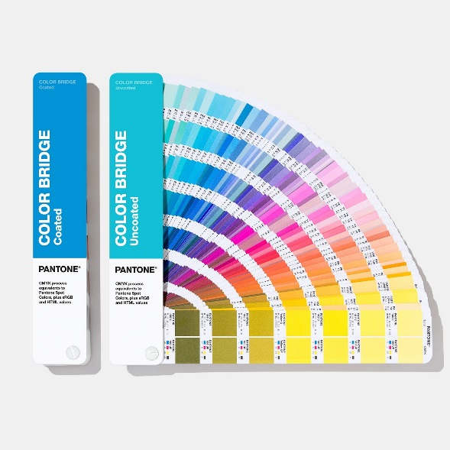
PANTONE
The Pantone Colour Matching System is largely a standardized colour reproduction system. By standardizing the colours, different manufacturers in different locations can all refer to the Pantone system to make sure colours match without direct contact with one another.

Slide 7
Printing processes
In the Advanced Higher Graphic Communication course, you need to have an understanding of the following printing processes:
  Offset Lithography
  Screen Printing
  Flexography
  Wide Format Printing
  Ink Jet Printing
  Laser Printing
  Solid Ink Print Systems

Slide 8
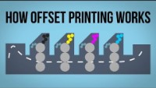
Offset Lithographic printing
Offset Lithography is fantastic for quick, high volume printing such as leaflets, books and magazines. Offset Litho can also print metallic colours and ‘duplex’ paper to print on both sides. However, they are expensive to setup!
Offset Lithographic is a four colour printing process and requires metal printing plates to be made for each colour in the process. This along with the cost of the machines is what makes it only cost effective when undertaking large print runs.
Advantages
  low cost for high volume print runs
  photographic quality, including spot-colours
  can print on different paper types and sizes
  Disadvantages
  Expensive initial set up costs

Slide 9
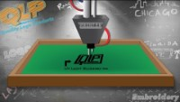
Screen Printing
Screen printing is actually a very old fashioned method of printing graphics. It works by ink being squeezed through a ‘mask’ onto the material below. It is slow, but great for making t-shirts, posters and other novelty items.
Advantages
  low cost print for mid-volume runs
  bright, vibrant colours
  can print on different materials - from paper to fabric
  Disadvantages
  a slow and sometimes messy process
  expensive to set up equipment
  liquid ink can take time to dry and can smudge
  cannot print photographs or high resolution graphics
  costs more due to slower production process. Can only do one colour at a time

Slide 10
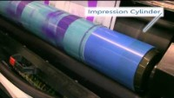
Flexographic printing
Flexography is a modern version of letterpress printing. This traditional method of printing can be used on almost any type of substrate, including corrugated cardboard, cellophane, plastic, label stock, fabric, and metallic film. The flexographic printing process uses quick-drying, semiliquid inks.
Advantages
  Runs at extremely high press speeds.
  Prints on a wide variety of substrate materials.
  Uses cost equipment that requires little maintenance.
  Uses relatively low-cost consumables.
  Is ideally suited for long runs
Disadvantages
  The cost of the flexo printing plates is high, but when they are properly cared for, they last for millions of impressions.

Slide 11
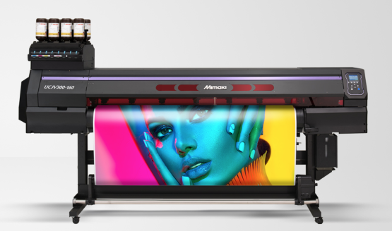
Wide Format printing
Large format printing is a part of almost Wide format printing is, essentially, the printing of large graphics or designs onto large rolls of paper (or other materials). It requires the use of specialist equipment, and much larger printers than standard commercial units.
Advantages
  can print in huge sizes
  printers can also cut contours of graphics
  photographic quality, including spot-colours
  can print on different paper types
  quick for short print runs of posters or displays
  Disadvantages
  solvent inks are very, very expensive
  liquid ink can take time to dry and can smudge

Slide 12
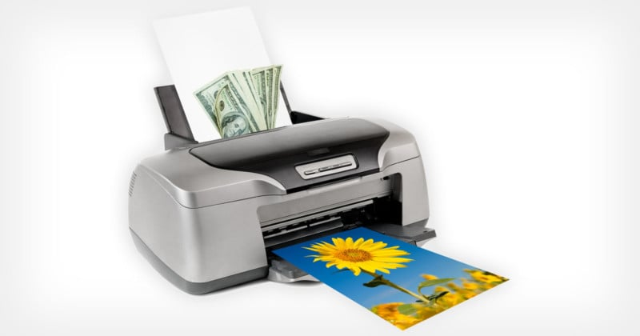
Ink jet printing
Ink Jet Printers are the most common format of printer to be found in homes, schools or offices. They are popular because they are easy to use, reliable and the printers are inexpensive.
However, printer ink is expensive, so they are only suited for short print runs or text based documents such as letters or essays.
Advantages
  photographic quality
  Relatively low hardware cost
  can print on different paper types
Disadvantages
  liquid ink can take time to dry and can smudge
  quick for short print runs
  only print on limited paper sizes, typically A5 to A3

Slide 13
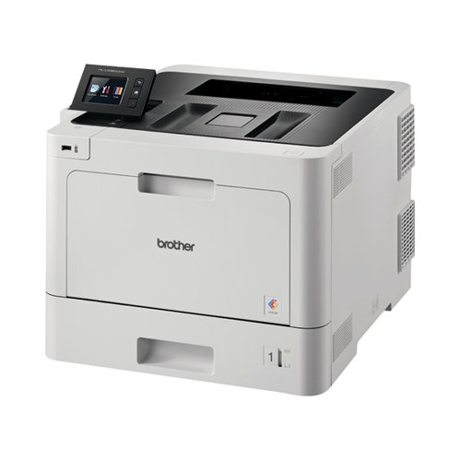
Laser printing
Laser printers are very quick and the ‘cost per-print’ is actually very low. Laser printers work by ‘fusing’ coloured toner dust to the paper. Toner is expensive, but you get a lot of prints. However, when parts such the ‘drum’ and ‘fuser’ start to go, costs soon mount up…
Advantages
  printers are fairly inexpensive to buy
  good quality, but not photographic
  very quick for short and medium print runs
  Disadvantages
  can only print on normal, non-gloss paper
  the expensive ‘fuser’ and ‘drum’ also need replaced
  only print on limited paper sizes, typically A5 to A3
  toner is expensive

Slide 14
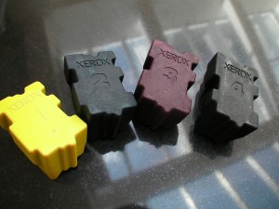
Solid Ink Print Systems
Solid Ink Print Systems
Solid ink is basically wax. Whereas other printer cartridges are filled with different types of ink, solid ink sticks, are exactly that- solid sticks of ink.
When they’re loaded into a solid ink printer and when you click print, the sticks are heated to melting point and the ink is then transferred onto the paper to produce the printed image. It’s a little bit similar to offset printing, where the image is produced and then placed onto the paper to create the print.
For this reason, if you ever take a look at a page printed by a solid ink machine, the texture of the print feels waxy to the touch

Slide 15
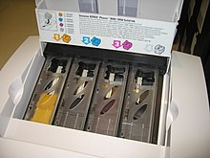
Solid Ink Print Systems
Solid Ink Print Systems (cont)
Advantages
When they were first launched, solid ink printers were aimed at graphic designers. That’s because the print quality allows for brilliant colour definition, particularly for lively colours such as oranges and yellows. The melted wax also creates a glossy surface across the top of the paper.
Unlike inkjet and laser printer cartridges, solid ink sticks mean that there is no empty cartridge to dispose of once the wax runs out. This means that less waste is created and there is no need to worry about finding a way to recycle your empty cartridges.
In addition, solid ink sticks don’t dry out in the way that ink cartridges do if a printer hasn’t been used for a long period of time. Solid ink sticks, can last forever.

Slide 16
Solid Ink Print Systems
Solid Ink Print Systems (cont)
Disadvantages
As they are thermal based, solid ink printers can take a good number of minutes to heat up before the first print and also need to pause and reheat in between prints. This can be very frustrating if you are
Also, solid ink printers need to complete a ‘cool down’ cycle after use. This means that the printer cannot be moved until this cycle is finished. However, this shouldn’t take any more than 10 minutes.in a hurry.
Solid ink printers aren’t cheap
You can’t print on photo paper / specialty papers.

Slide 17
Other Printing Terms
Edge to Edge printing
A full bleed or edge to edge printing is when the graphics extend to the physical edge of the
paper on all edges. A bleed is required on all edges of the publication. Usually commercial printers
will achieve an edge to edge look by cropping the paper to size after the print however modern
inkjet printers now can print to the actual edge of the paper by over spraying the page, this method
however does waste ink. Off-set lithography printing (the most common commercial method) requires
printing on OS (oversized) paper which is then trimmed to size
Bleed
If you want a graphic to reach the edge of the paper you need to extend the graphic outside the edge
of the publication. This is known as a bleed. Graphic designers usually add a bleed margin during the
page set up and extend items by 3mm or 5mm to achieve a bleed. The publication is printed on
oversized (OS) paper to enable this additional bleed size. The paper is trimmed to size after printing.
Gutter
The vertical space or alley space between columns of text is referred to as the gutter. It also refers
to the inside margins or blank space between two facing pages. In this case the gutter space may
need to be adjusted to allow for creep, the movement associated with some book binding methods
Registration Marks
When off-set lithography printing with multiple plates for each individual colour (e.g. CMYK) precise alignment is needed to ensure each plate/colour is printed exactly on top of the others. This is called registration. The registration marks (right) are positioned in the margins of each page to help the printer operator to align the colours on the press properly. They are trimmed off during cropping.

Slide 18
Other Printing Terms (continued)
Colour Calibration
Colours will appear duller when printed than to what they look like on screen (difference of RGB/CMYK colours and issues of monitors having independent colour values). This can cause issues for a designer who may unwittingly make his colours too bright or too warm (monitors are often too blue-ish in hue). In order to avoid this, the monitor should be calibrated to match the printer. A colour calibration device is set on the screen which reads the colours and brightness of the display and then adjusts the colour settings of the output to match a dataset of colour values. Likewise it is important that a printer also bases it colours on the same dataset of colour values - so that both printer and screen match. The colour values of a printed sheet can be scanned and checked by a calibration device and then the printer colour data calibrated accordingly.
Dots per Inch (DPI)
Refers to the number of dots that can be printed within 1 inch. The higher the number of dots
(resolution), the sharper and clearer the image. For photos to appear crisp and sharp they need to
have a resolution of around 300 dpi. Many screens only output at around approx 100 pixels per inch (PPI) so images for screen can have a smaller file size. Your school printer will print to a resolution of 300dpi
Photo Reduction
This refers to the compression of image files so that they are a smaller file size but with limited loss of quality. This is useful for images for the web as it allows for quicker load times. Photo editing programs reduce file size by removing meta data such as camera model, white balance and photo date and so on. This could reduce a file from around 4MB to 1MB relatively easily
Duplexing
Put simply, it is when a printer can print on both sides of a sheet of paper. Duplexing is achieved when the printer catches the piece of paper after the first side has been printed on, then flips it, and prints again.

Slide 19
Other Printing Terms (continued)
Camera Ready Copy
This is the final stage of a publication before it is printed. The document will have been exported as either a EPS file or a PDF file; it will be set for the correct colour scheme, and will be set to the correct size for printing without any need for scaling. Fonts should be set to vector graphics, and any raster images should be at least 300 Dpi.
Paper Weight
Paper is measured in GSM - “Grams per Square Metre”. Low quality sheets have a Low GSM value; such as the paper used in a photocopier (approx. 80 GSM). High quality paper has a higher value GSM; such as the paper used to print on Leaflets/flyers (approx. 130 GSM).
Paper Opacity
Paper opacity describes how much light can pass through a piece of paper. Paper with High Opacity is good for duplex printing as not much light can pass through and you are unlikely to be able to see what’s been printed on the opposite side. Paper with Low Opacity allows light to pass through easily; for example Tracing
Paper.
Calendaring
Calendaring is the process of smoothing the surface of a piece of paper by pressing it between cylinders or rollers. This produces a very smooth, uniform surface on the paper, which then makes it suitable to have a gloss coating applied. The gloss coating requires a very smooth, flat surface rather than a rough, bumpy one.

